Slide 1
COMPUTER ORGANIZATION & ARCHITECTURE

Slide 2
Unit-4
Central Processing Unit

Slide 3
Central Processing Unit
1. Introduction
2. General Register Organization
3. Stack Organization
4. Instruction Formats
5. Addressing Modes
6. Data Transfer and Manipulation
7. Program Control
8. Reduced Instruction Set Computer(RISC)

Slide 4
Central Processing Unit
The Components with in the CPU
1) Register Sets
2) Arithmetic and Logical Unit
3) Control Unit
Register sets
Single Accumulator organization (Special purpose reg)
b) General Register Organization
c) Stack Organization

Slide 5
MAJOR COMPONENTS OF CPU
Storage Components
Registers
Flags
Execution (Processing) Components
Arithmetic Logic Unit(ALU)
Arithmetic calculations, Logical computations, Shifts/Rotates
Transfer Components
Bus
Control Components
Control Unit
Register
File
ALU
Control Unit

Slide 6
In general, most processors are organized in one of 3 ways
1. Single register (Accumulator) organization
Basic Computer is a good example
Accumulator is the only general purpose register
2. General register organization
Used by most modern computer processors
Any of the registers can be used as the source or destination for computer operations
3. Stack organization
All operations are done using the hardware stack
For example, an OR instruction will pop the two top elements from the stack, do a logical OR on them, and push the result on the stack

Slide 7
In a Single Accumulator Organization there are few special purpose registers
In any CPU the total registers can be divided into different groups
i) General purpose registers ii) Special purpose registers
Special purpose registers
PC – Program Counter
AR – Address Register
IR – Instruction Register
DR – Data Register
AC – Accumulator
TR – Temporary Register
INRR – Input Register
OUPR – Output Register
General Purpose Register
R1
.
.
.
.
.
.
.
Rn

Slide 8
Control word
A general organization of seven CPU registers
Consider R1 ← R2 + R3, the following are the functions implemented within the CPU
MUX A Selector (SELA) − It can place R2 into bus A.
MUX B Selector (SELB) − It can place R3 into bus B.
ALU Operation Selector (OPR) − It can select the arithmetic addition (ADD).
Decoder Destination Selector (SELD) − It can transfers the result into R1.
Bus organization for CPU registers

Slide 9
Encoding of Register Selection Fields
Encoding of ALU operations
Control word

Slide 10
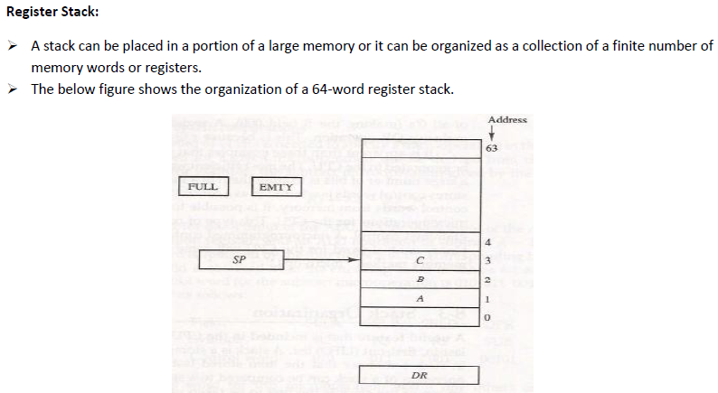
10
Notes:
CS252 S05
10

Slide 11
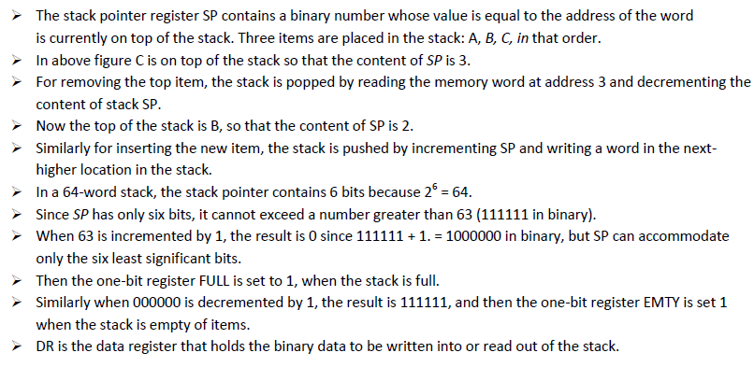

Slide 12
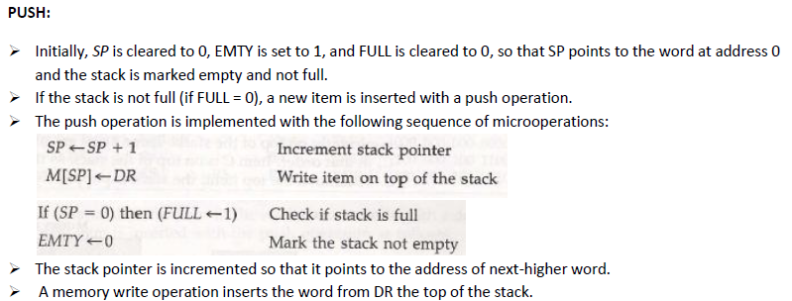
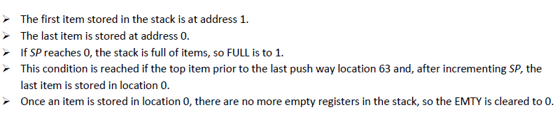

Slide 13
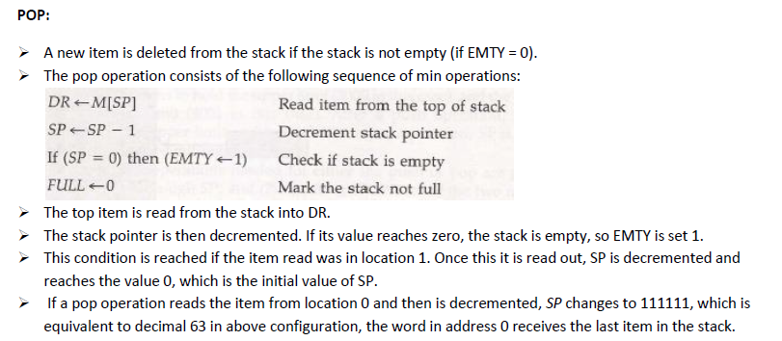

Slide 14
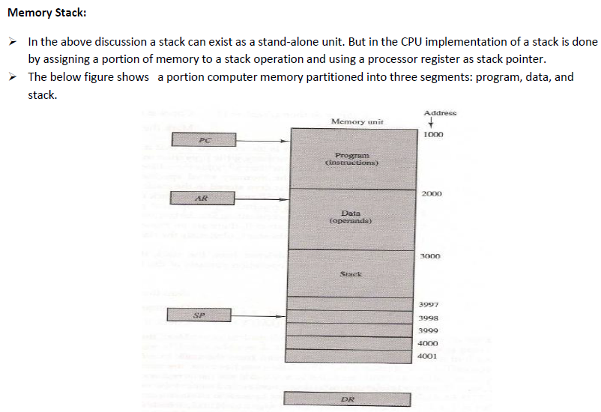

Slide 15
The program counter PC points at the address of the next instruction in program.
The address register AR points at an array of data.
The stack pointer SP points at the top of the stack.
The three registers are connected to a common address bus, and either one can provide an address for memory.
1) PC is used during the fetch phase to read an instruction.
2) AR is used during the exec phase to read an operand.
3) SP is used to push or pop items into or from stack.
Thus the first item stored in the stack is at address 4000, the second item is stored at address 3999, and the last address that can be used for the stack is 3000.
No provisions are available for stack limit checks.
The items in the stack communicate with a data register DR. A new item is inserted with the push operation as follows:
SP<- SP-1
M [SP] <- DR
The stack pointer is decremented so that it points at the address of the next word.
A memory write operation inserts the word from DR into the top of stack. A new item is deleted with a pop operation as
DR ← M [SP]
SP← SP+1

Slide 16
REVERSE POLISH NOTATION
In-fix expression (X + Y)
Pre-fix or polish notation ( +XY )
Post fix expression or reverse polish notation (XY +)
Arithmetic Expressions: A + B
A + B Infix notation
+ A B Prefix or Polish notation
A B + Postfix or reverse Polish notation
- The reverse Polish notation is very suitable for stack manipulation

Slide 17
The reverse Polish notation is in a form suitable for stack manipulation.
The expression A*B+C*D Is written in reverse polish notation as AB* CD* + And it is evaluated as follows
✓ Scan the expression from left to right.
✓ When operator is reached, perform the operation with the two operands found on the left side of the operator.
✓ Remove the two operands and the operator and replace them by the number obtained from the result of the operation.
Continue to scan the expression and repeat the procedure for every operation encountered until there are no more operators.
For the expression above it find the operator * after A and B. So it perform the operation A*B and replace A, B and * with the result.
The next operator is a * and it previous two operands are C and D, so it perform the operation C*D and places the result in places C, D and *.
The next operator is + and the two operands to be added are the two products, so we add the two quantities to obtain the result.
The conversion from infix notation to reverse Polish notation must take into consideration the operational hierarchy adopted for infix notation.
➢ This hierarchy dictates that we first perform all arithmetic inside inner parentheses, then inside outer parentheses, and do multiplication and division operations before addition and subtraction operations.

Slide 18
Evaluation of Arithmetic Expressions
Any arithmetic expression can be expressed in parenthesis-free
Polish notation, including reverse Polish notation
(3 * 4) + (5 * 6) ⇒ 3 4 * 5 6 * +
6
4
5
5
30
3
3
12
12
12
12
42
3
4
*
5
6
*
+

Slide 19
INSTRUCTION FORMAT
Instruction Fields
OP-code field - specifies the operation to be performed
Address field - designates memory address(es) or a processor register(s)
Mode field - determines how the address field is to be interpreted (to
get effective address or the operand)
The number of address fields in the instruction format
depends on the internal organization of CPU
The three most common CPU organizations:
Single accumulator organization:
ADD X /* AC ← AC + M[X] */ CLA – Clear the accumulator; CMA
General register organization:
ADD R1, R2, R3 /* R1 ← R2 + R3 */
ADD R1, R2 /* R1 ← R1 + R2 */
MOV R1, R2 /* R1 ← R2 */
ADD R1, X /* R1 ← R1 + M[X] */
Stack organization:
PUSH X /* TOS ← M[X] */
ADD

Slide 20
THREE, AND TWO-ADDRESS INSTRUCTIONS
Three-Address Instructions
Program to evaluate X = (A + B) * (C + D) :
ADD R1, A, B /* R1 ← M[A] + M[B] */
ADD R2, C, D /* R2 ← M[C] + M[D] */
MUL X, R1, R2 /* M[X] ← R1 * R2 */
- Results in short programs
- Instruction becomes long (many bits)
Two-Address Instructions
Program to evaluate X = (A + B) * (C + D) :
MOV R1, A /* R1 ← M[A] */
ADD R1, B /* R1 ← R1 + M[A] */
MOV R2, C /* R2 ← M[C] */
ADD R2, D /* R2 ← R2 + M[D] */
MUL R1, R2 /* R1 ← R1 * R2 */
MOV X, R1 /* M[X] ← R1 */

Slide 21
ONE, AND ZERO-ADDRESS INSTRUCTIONS
One-Address Instructions
- Use an implied AC register for all data manipulation
- Program to evaluate X = (A + B) * (C + D) :
LOAD A /* AC ← M[A] */
ADD B /* AC ← AC + M[B] */
STORE T /* M[T] ← AC */
LOAD C /* AC ← M[C] */
ADD D /* AC ← AC + M[D] */
MUL T /* AC ← AC * M[T] */
STORE X /* M[X] ← AC */
Zero-Address Instructions
- Can be found in a stack-organized computer
- Program to evaluate X = (A + B) * (C + D) :
PUSH A /* TOS ← A */
PUSH B /* TOS ← B */
ADD /* TOS ← (A + B) */
PUSH C /* TOS ← C */
PUSH D /* TOS ← D */
ADD /* TOS ← (C + D) */
MUL /* TOS ← (C + D) * (A + B) */
POP X /* M[X] ← TOS */

Slide 22
X = (A + B) * (C + D)
Three Instruction format ADD R1, A, B R1 ← M[A] + M[B] ADD R2, C, D R2 ← M[C] + M[D] MUL X, R1, R M[X] ← R1 * R2 | Two Instruction format MOV R1, A R1 ← M[A] ADD R1, B R1 ← R1 + M[B] MOV R2, C R2 ← M[C] ADD R2, D R2 ← R2 + M[D] MUL R1, R2 R1 ← R1 * R2 MOV X, R1 M[X] ← R1
Single Instruction format LOAD A AC ← M[A] ADD B AC ← AC + M[B] STORE T M[T] ← AC LOAD C AC ← M[C] ADD D AC ← AC + M[D] MUL T AC ← AC * M[T] STORE X M[X] ← AC | Zero Instruction format PUSH A TOS ← A PUSH B TOS ← B ADD TOS ← (A + B) PUSH C TOS ← C PUSH D TOS ← D ADD TOS ← (C + D) MUL TOS ← (C + D) * (A + B) POP X M[X] ← TOS

Slide 23
X = (A + B) * (C + D) CISC-Complex instruction Set Computer RISC- Reduced instruction Set Computer
Reduced instruction set Computer (RISC) LOAD R1, A R1 ← M[A] LOAD R2, B R2 ← M[B] LOAD R3, C R3 ← M[C] LOAD R4, D R4 ← M[D] ADD R1, R2 R1 ← R1 + R2 ADD R3, R4 R3 ← R3 + R4 MUL R1, R3 R1 ← R1 * R3 STORE X, R1 M[X] ← R1

Slide 24
Addressing Modes
The way the operands are chosen during program execution is dependent on the addressing mode of the instruction.
Computers use addressing mode techniques for the purpose of accommodating one or both of the following provisions:
1) To give programming versatility to the user by providing such facilities as pointers to memory, counters for loop control, indexing of data, and program relocation.
2) To reduce the number of bits in the addressing field of the instruction
➢ Most addressing modes modify the address field of the instruction; there are two modes that need no address field at all. These are implied and immediate modes.

Slide 25
Types of Addressing Modes
Implied
Immediate
Register
Register Indirect
Autoincrement
AutoDecrement
Direct
Indirect
Relative
Base Register
Indexed

Slide 26
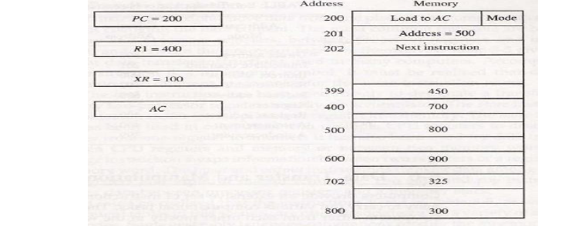

Slide 27
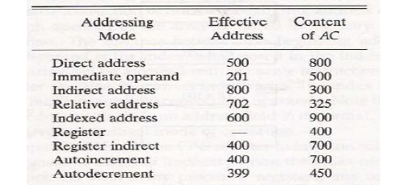

Slide 28
Implied Mode:
✓ In this mode the operands are specified implicitly in the definition of the instruction.
For example, the instruction "complement accumulator" is an implied-mode instruction because the operand in the accumulator register is implied in the definition of the instruction.
CLA –Clear Accumlator
✓ All register reference instructions that use an accumulator are implied mode instructions.
Immediate Mode:
✓ In this mode the operand is specified in the instruction itself.
✓ In other words an immediate-mode instruction has an operand rather than an address field.
✓ Immediate-mode instructions are useful for initializing registers to a constant value.
➢ The address field of an instruction may specify either a memory word or a processor register.
➢ When the address specifies a processor register, the instruction is said to be in the register mode.
Register Mode:
✓ In this mode the operands are in registers that reside within the CPU.
✓ The particular register is selected from a register field in the instruction.

Slide 29
Register Indirect Mode:
✓ In this mode the instruction specifies a register in CPU whose contents give the address of the operand in memory.
✓ In other words, the selected register contains the address of the operand rather than the operand itself.
✓ The advantage of a register indirect mode instruction is that the address field of the instruction uses few bits to select a register than would have been required to specify a memory address directly.
Auto-increment or Auto-Decrement Mode:
✓ This is similar to the register indirect mode except that the register is incremented or decremented after (or before) its value is used to access memory.
➢ The address field of an instruction is used by the control unit in the CPU to obtain the operand from memory.
➢ Sometimes the value given in the address field is the address of the operand, but sometimes it is just an address from which the address of the operand is calculated.
➢ The basic two mode of addressing used in CPU are direct and indirect address mode.

Slide 30
Direct Address Mode:
✓ In this mode the effective address is equal to the address part of the instruction.
✓ The operand resides in memory and its address is given directly by the address field of the instruction.
✓ In a branch-type instruction the address field specifies the actual branch address.
Indirect Address Mode:
✓ In this mode the address field of the instruction gives the address where the effective address is stored in memory.
✓ Control fetches the instruction from memory and uses its address part to access memory again to read the effective address.
➢ A few addressing modes require that the address field of the instruction be added to the content of a specific register in the CPU.
➢ The effective address in these modes is obtained from the following computation:
Effective address =address part of instruction + content of CPU register
➢ The CPU register used in the computation may be the program counter, an index register, or a base register.
➢ We have a different addressing mode which is used for a different application.

Slide 31
Relative Address Mode:
✓ In this mode the content of the program counter is added to the address part of the instruction in order to obtain the effective address.
Indexed Addressing Mode:
✓ In this mode the content of an index register is added to the address part of the instruction to obtain the effective address.
✓ An index register is a special CPU register that contains an index value.
Base Register Addressing Mode:
✓ In this mode the content of a base register is added to the address part of the instruction to obtain the effective address.
✓ This is similar to the indexed addressing mode except that the register is now called a base register instead of an index register.

Slide 32
DATA TRANSFER INSTRUCTIONS
Name Mnemonic
Typical Data Transfer Instructions
Load LD
Store ST
Move MOV
Exchange XCH
Input IN
Output OUT
Push PUSH
Pop POP
Data Transfer Instructions with Different Addressing Modes
Mode
Assembly
Convention
Register Transfer
Direct address LD ADR AC ← M[ADR]
Indirect address LD @ADR AC ← M[M[ADR]]
Relative address LD $ADR AC ← M[PC + ADR]
Immediate operand LD #NBR AC ← NBR
Index addressing LD ADR(X) AC ← M[ADR + XR]
Register LD R1 AC ← R1
Register indirect LD (R1) AC ← M[R1]
Autoincrement LD (R1)+ AC ← M[R1], R1 ← R1 + 1
Autodecrement LD -(R1) R1 ← R1 - 1, AC ← M[R1]

Slide 33
DATA MANIPULATION INSTRUCTIONS
Three Basic Types:
Arithmetic instructions
Logical and bit manipulation instructions
Shift instructions
Arithmetic Instructions
Name Mnemonic
Increment INC
Decrement DEC
Add ADD
Subtract SUB
Multiply MUL
Divide DIV
Add with Carry ADDC
Subtract with Borrow SUBB
Negate(2’s Complement) NEG
Logical and Bit Manipulation Instructions
Name Mnemonic
Shift Instructions
Clear CLR
Complement COM
AND AND
OR OR
Exclusive-OR XOR
Clear carry CLRC
Set carry SETC
Complement carry COMC
Enable interrupt EI
Disable interrupt DI
Name Mnemonic
Logical shift right SHR
Logical shift left SHL
Arithmetic shift right SHRA
Arithmetic shift left SHLA
Rotate right ROR
Rotate left ROL
Rotate right thru carry RORC
Rotate left thru carry ROLC

Slide 34
Control memory

Slide 35
Address Sequencing

Slide 36
Micro Programme Example

Slide 38
Design of Control Unit

